Slide 1
Implementation of PKI With RBC engine and pre-enrollment
INF639 Project 3
Zaoyi CHI
Qian ZHao

Slide 2
Table of contents
Review the architecture of TA-PKI
Our project design
Improvement of our design
Demonstration

Slide 3
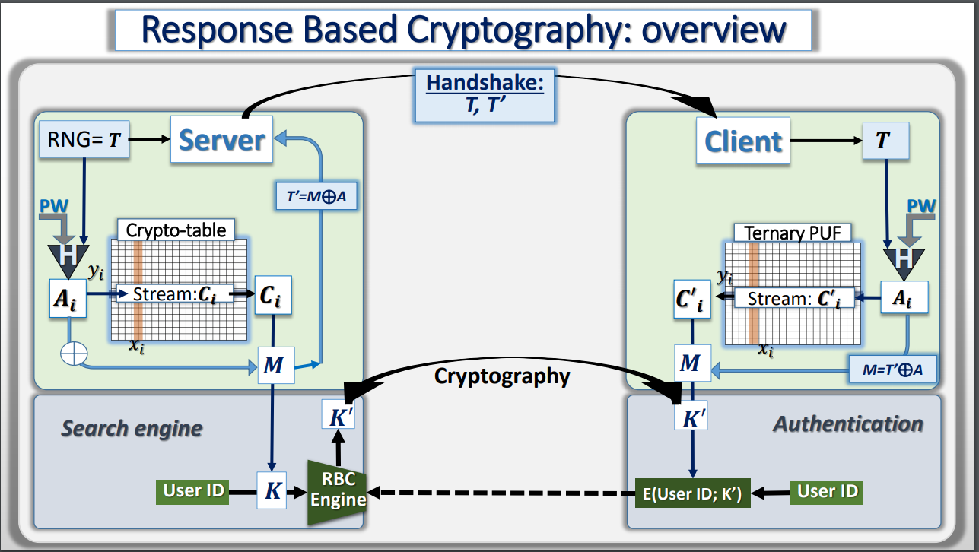
Review the architecture of TA-PKI

Slide 4
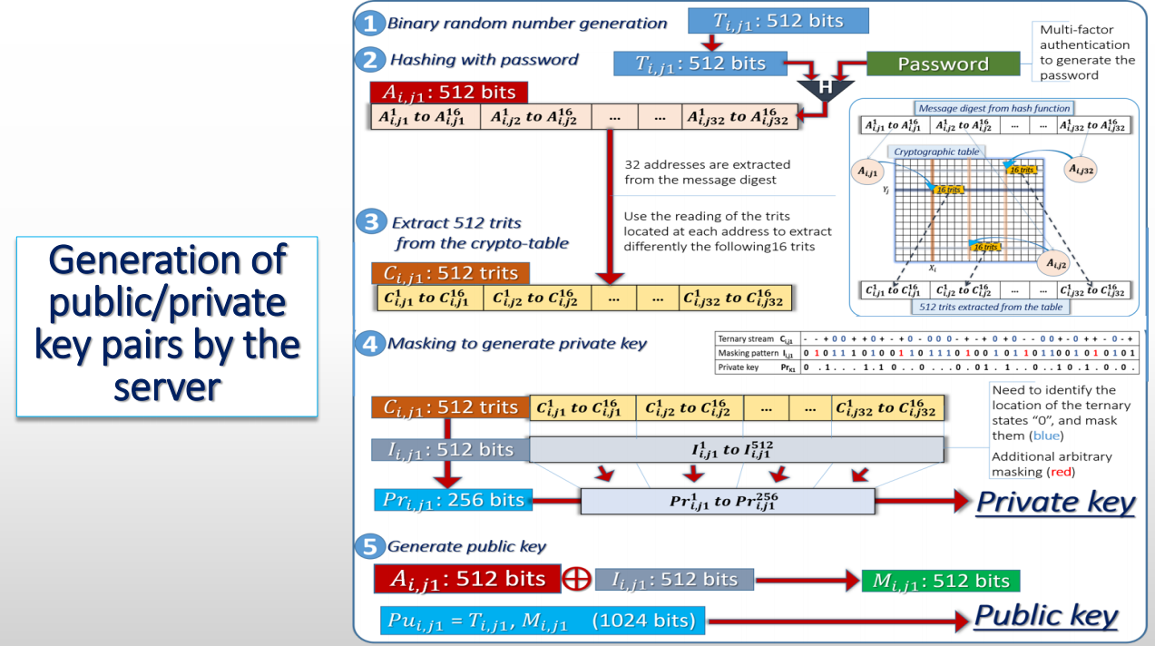
Review the architecture of TA-PKI

Slide 5
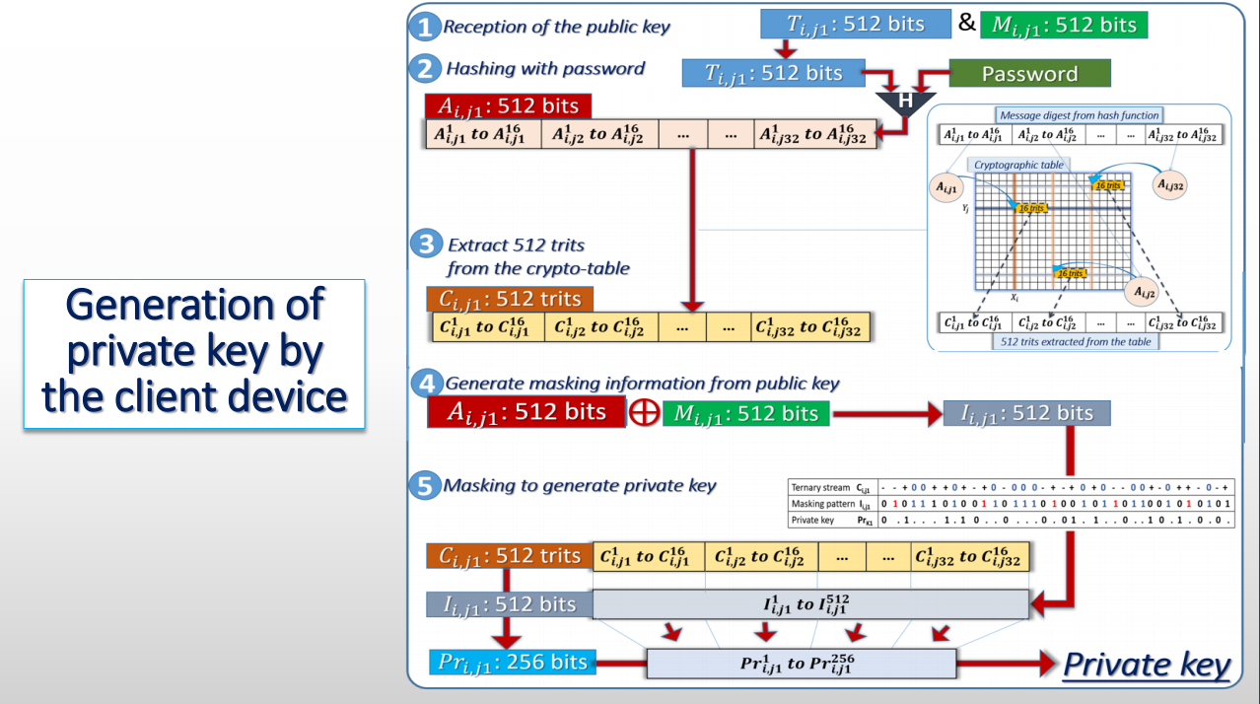
Review the architecture of TA-PKI

Slide 6
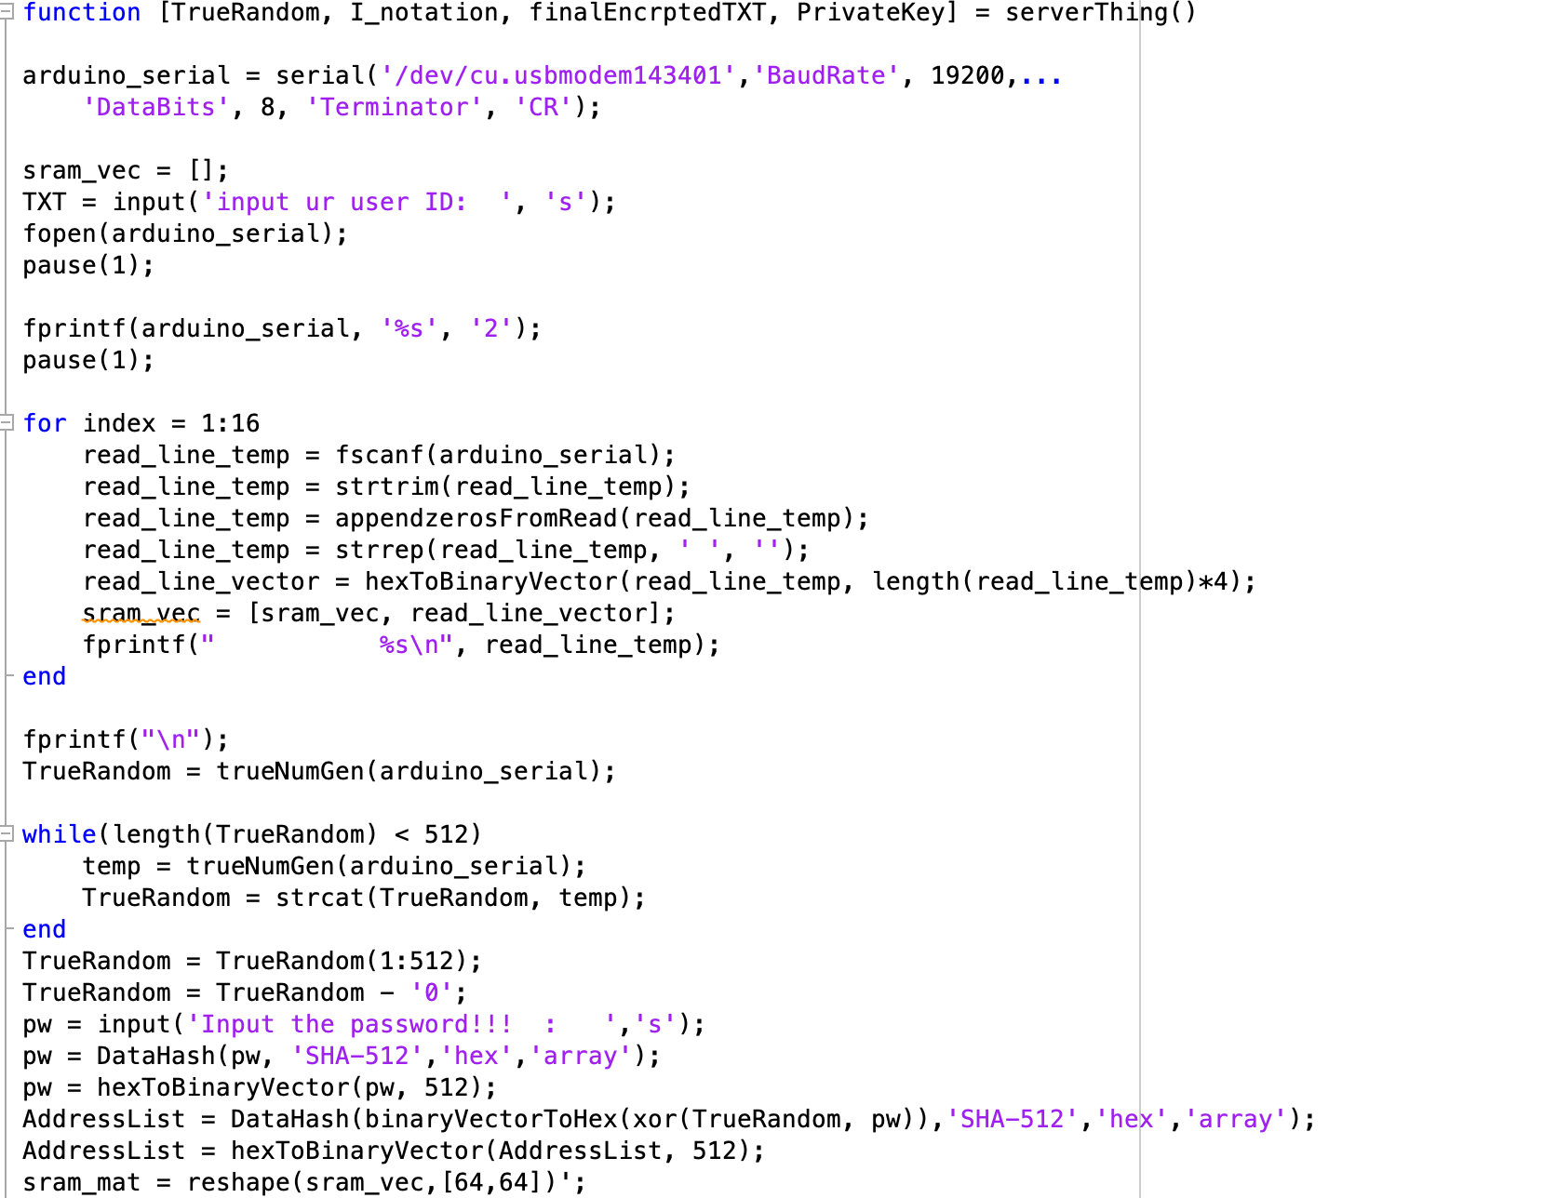
Our project design
SERVER
PUF design (64 x 64) matrix from Arduino Sram
HASH Password

Slide 7

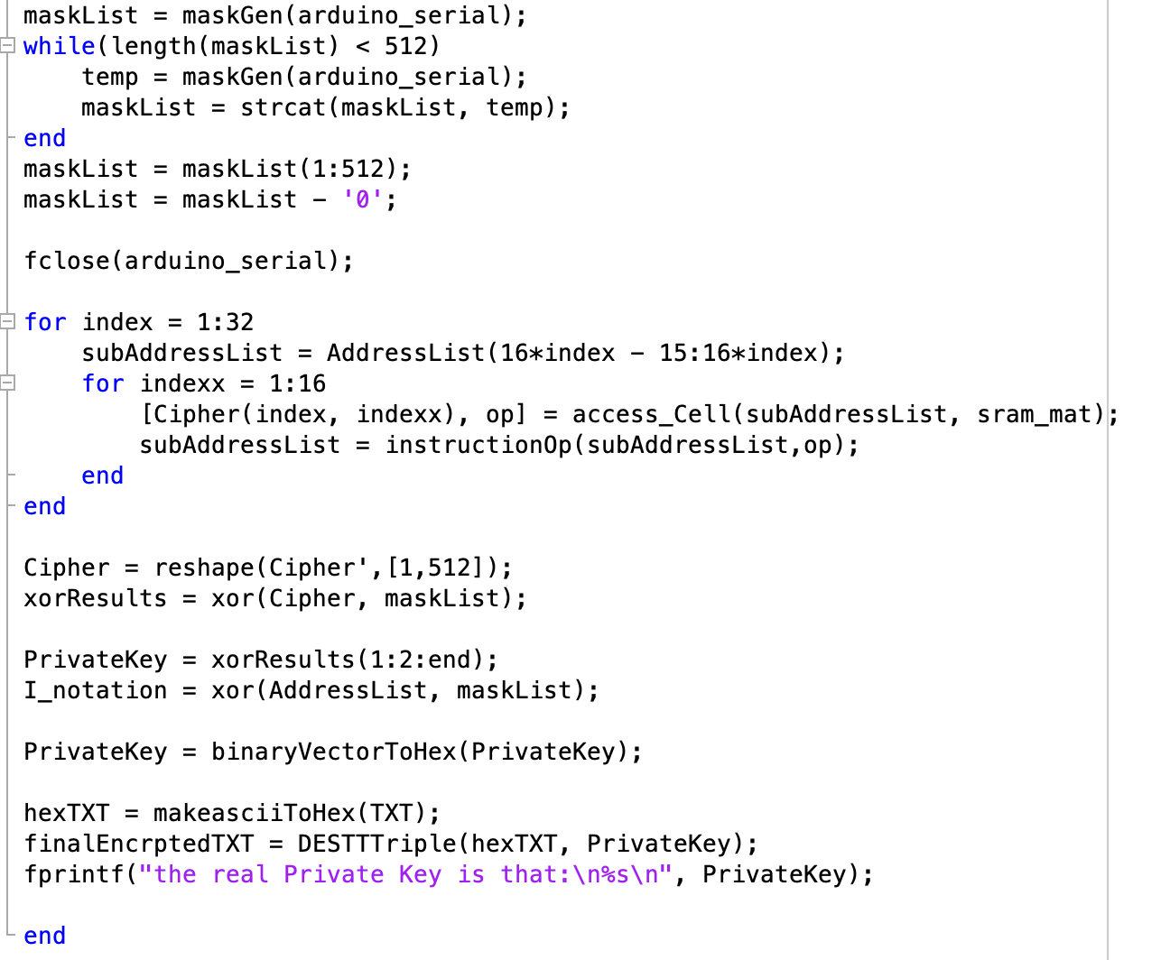



Our project design
Masking and generate private key

Slide 8
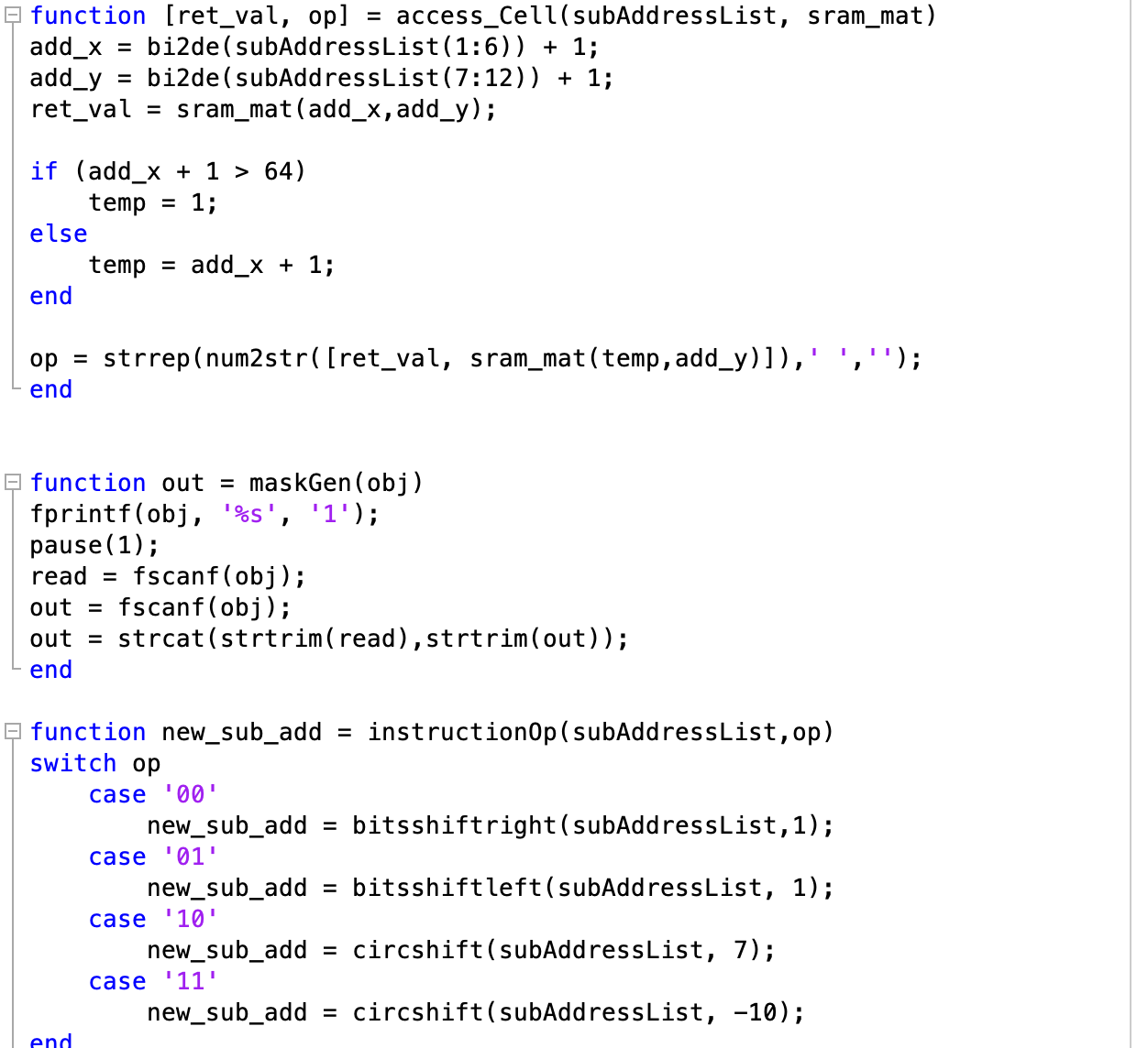
Our project design

Slide 9
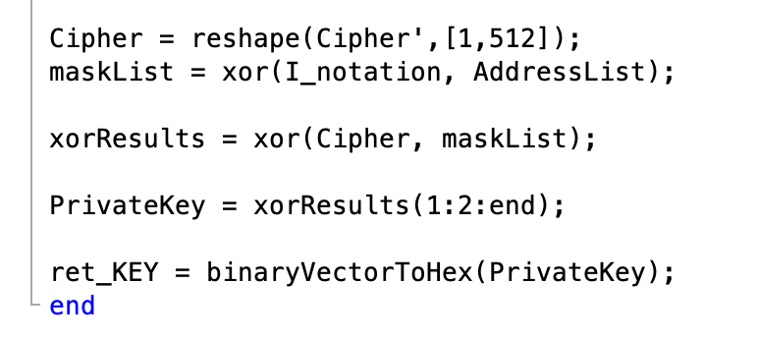
Our project design
Client

Slide 10
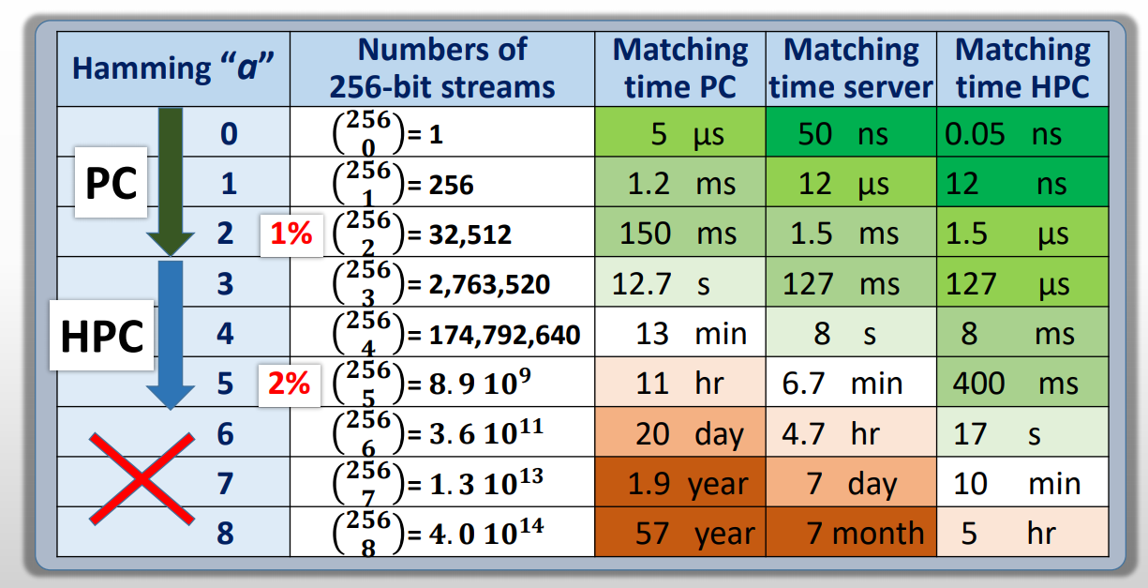
Improvement of our design
Drawback of RBC Engine
Improvement

Slide 11
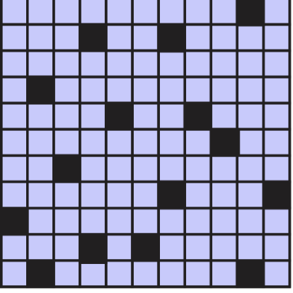
Improvement of our design

Slide 12
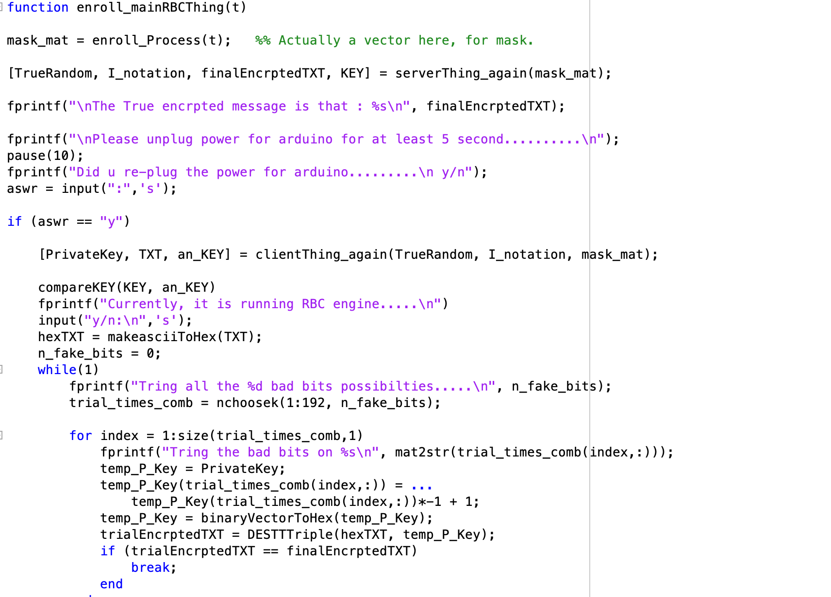
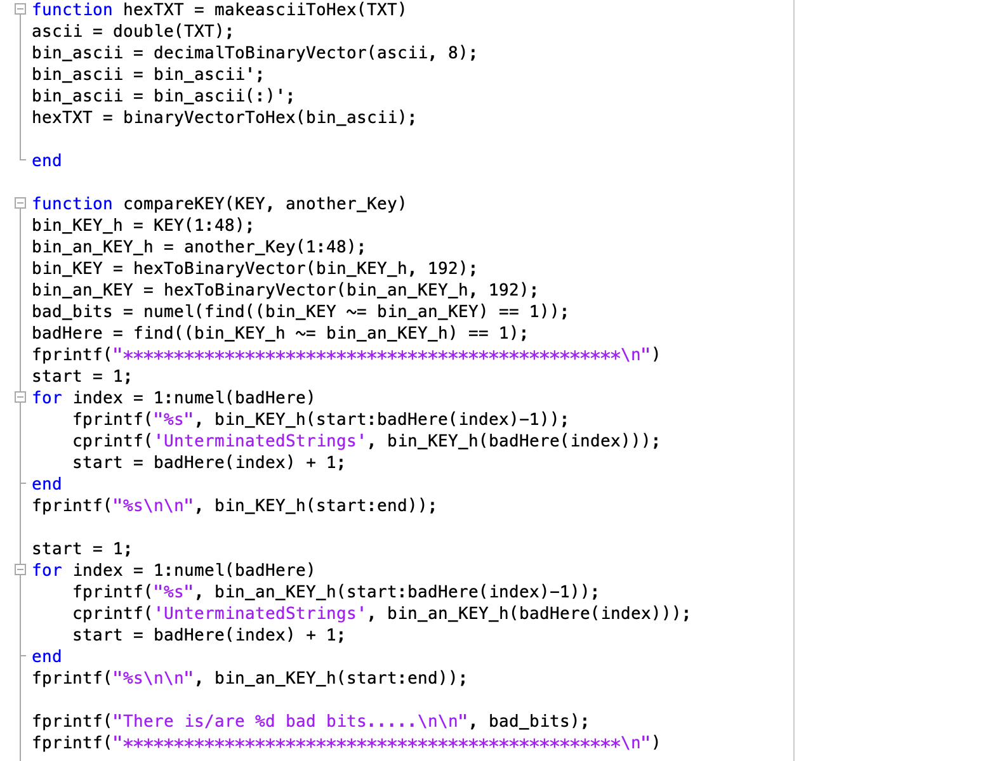
Improvement of our design

Slide 13
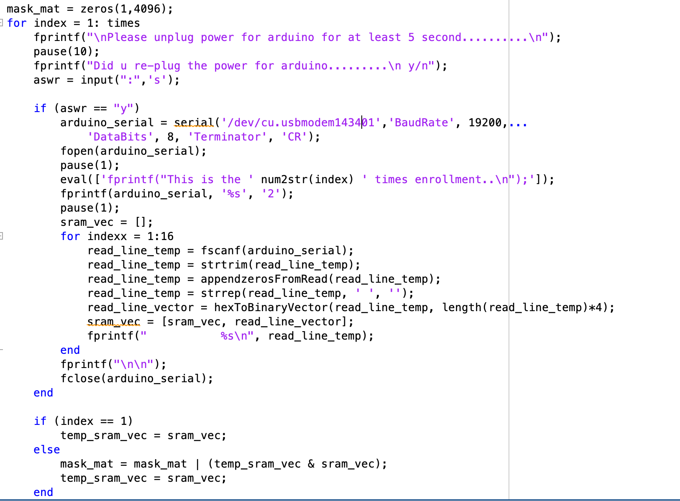
Improvement of our design

Slide 14
Demonstration

Slide 15
Questions?

